Slide 1
Empirical Study Of Random Projection
EE535P-Systems Design
PRESENTED BY
Prajyot Morey T21009
M.Tech (CSP)
INSTRUCTOR
Dr. Rameshwar Pratap

Slide 2
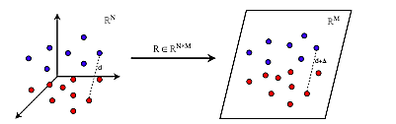
CONTENTS
Objective
Motivation
Expected Output
Results and Plots
TimeLine
Gratitude
Picture Courtesy Internet

Slide 3
Objective
To Show Superiority of Random Projection over Principle Component Analysis when applied Over a mixture of gaussian in High Dimensions.
To Show Projected dimension is independent of the original dimension.
To show that after projecting high dimensional data to low dimension the Eccentricity of the Gaussian will decrease and gaussian become more spherical.
To find the separation between clusters of gaussian before and after transforming to low dimensions.

Slide 4
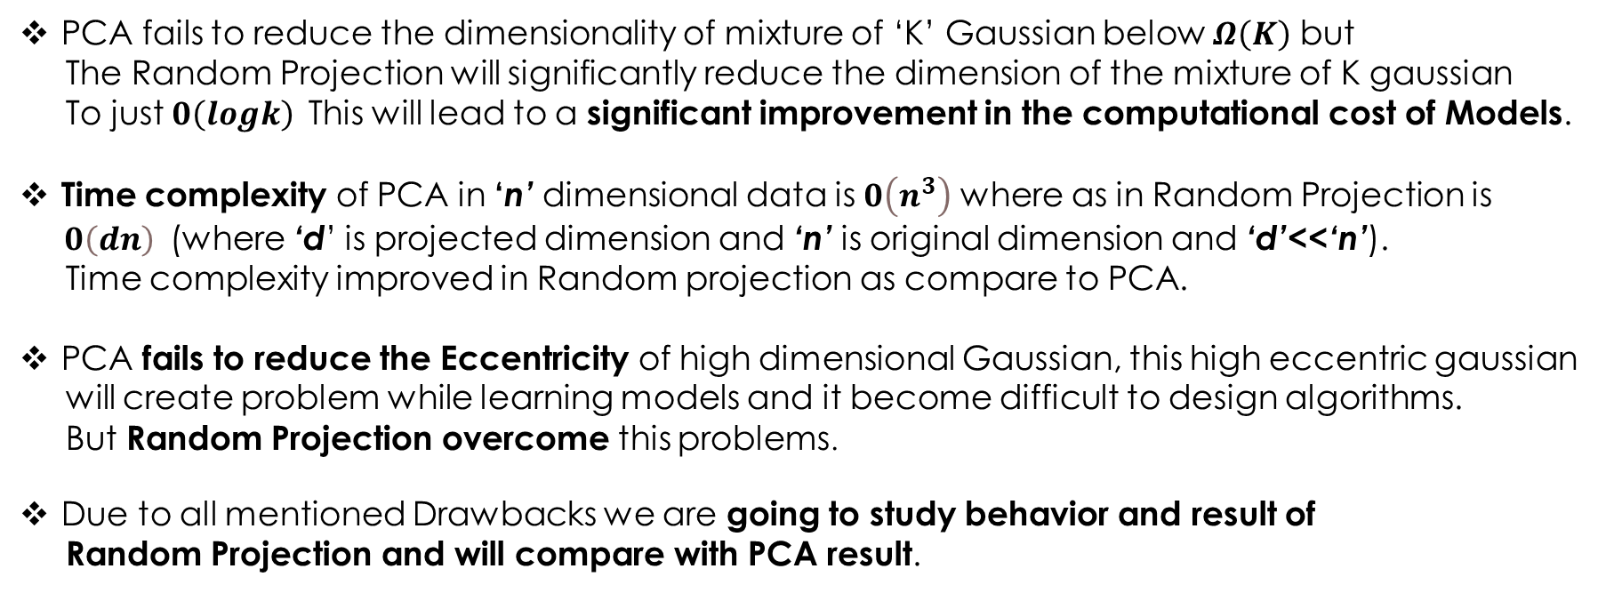
Motivation
??
Why Random Projection?
PCA fails to reduce the dimensionality of mixture of ‘K’ Gaussian below $Ω\left(K\right)$ but
The Random Projection will significantly reduce the dimension of the mixture of K gaussian
To just $0\left(logk\right)$This will lead to a significant improvement in the computational cost of Models.
Time complexity of PCA in ‘n’ dimensional data is $0\left(n^{3}\right)$ where as in Random Projection is
$0\left(ⅆn\right)$(where ‘d’ is projected dimension and ‘n’ is original dimension and ‘d’<<‘n’).
Time complexity improved in Random projection as compare to PCA.
PCA fails to reduce the Eccentricity of high dimensional Gaussian, this high eccentric gaussian
will create problem while learning models and it become difficult to design algorithms.
But Random Projection overcome this problems.
Due to all mentioned Drawbacks we are going to study behavior and result of
Random Projection and will compare with PCA result.

Slide 5
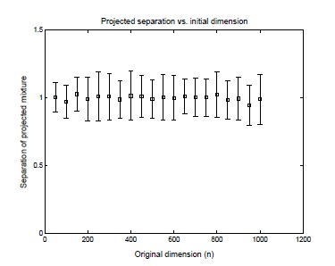
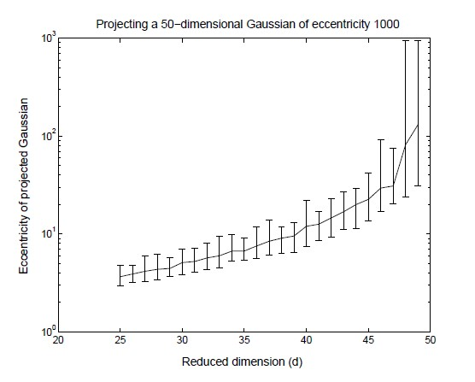
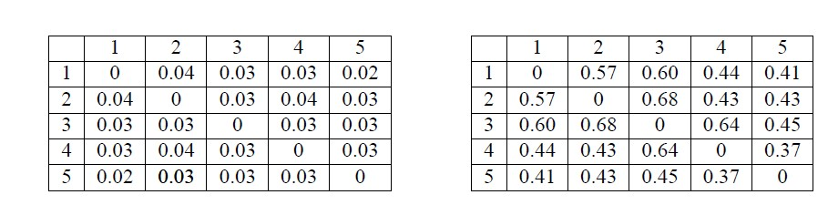
Expected Outputs
Fig. 1. The above Graphs show that the Projected dimension is independent of the original Dimension. From: Dasgupta, S. (2013), Figure 3,Experiments with Random Projection.
Fig.2 Above graphs show that the Eccentricity of gaussian is reduced as it is projected into low dimensions. From: From: Dasgupta, S. (2013), Figure 6, Experiments with Random Projection.
Fig. 3. Above figure gives idea How inter-cluster separation is affected after projecting to low dimension, left matrix represented output from PCA and right Matrix represented output from Random Projection. From: Dasgupta, S. (2013), Figure 7, Experiments with Random Projection

Slide 6
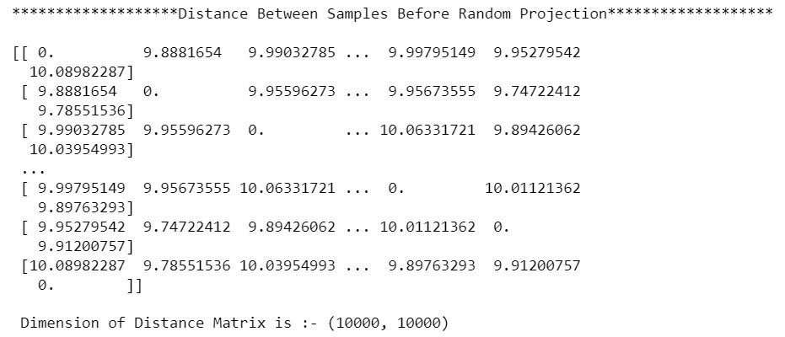
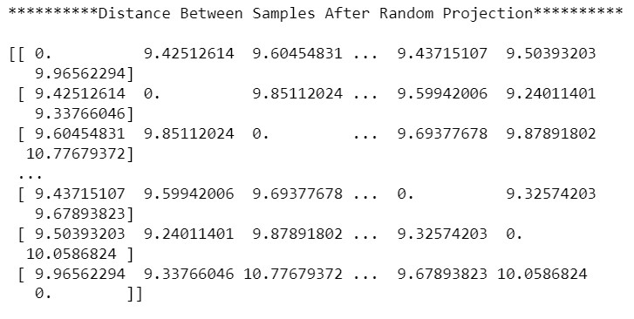
Results and Outputs
Experiment_1_A
Distance Between Samples before Random Projection
Distance Between Samples After Random Projection

Slide 7
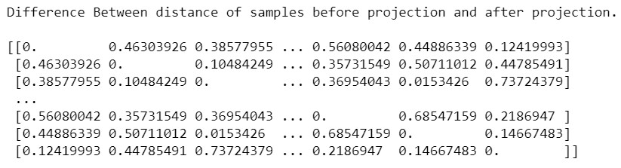
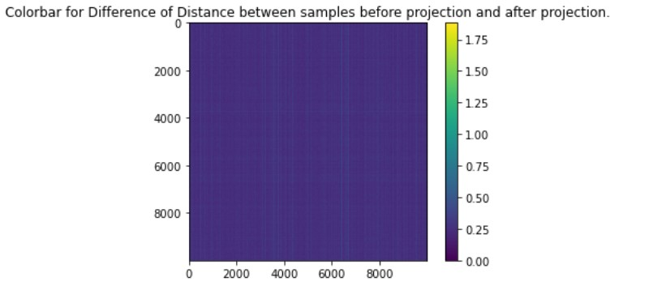
Difference between the distance of samples before and after projection.
Heatmap for difference matrix.

Slide 8
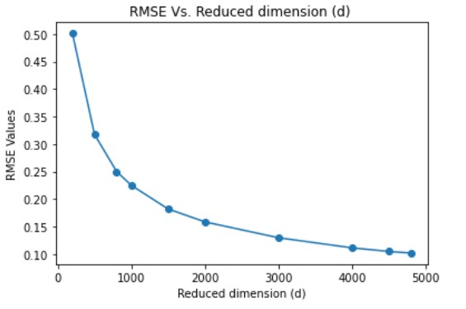
Experimen_1_B&C
Fig. 4. The above Graphs show that the Projected dimension is independent of the original Dimension. From: Dasgupta, S. (2013), Figure 3, Experiments with Random Projection.

Slide 9
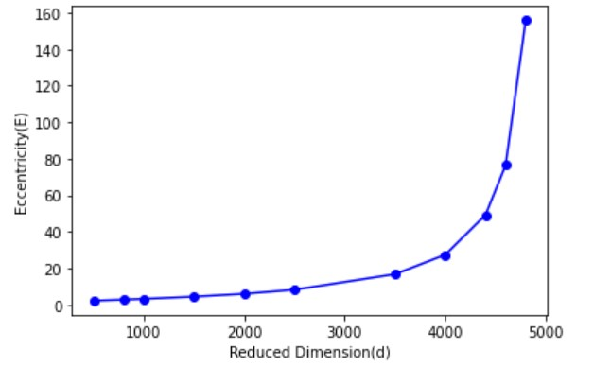
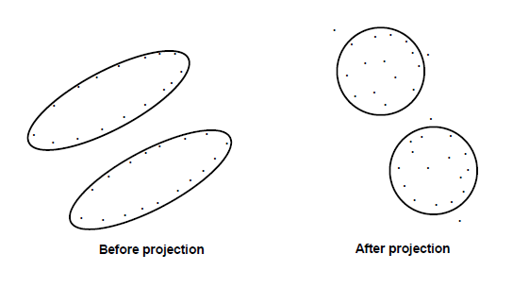
Figure 5: The effects of random projection: the dimension is drastically reduced while the clusters remain well-separated become more spherical. From: Dasgupta, S. (2013), Figure 2, Experiments with Random Projection.
Experiment_2

Slide 10
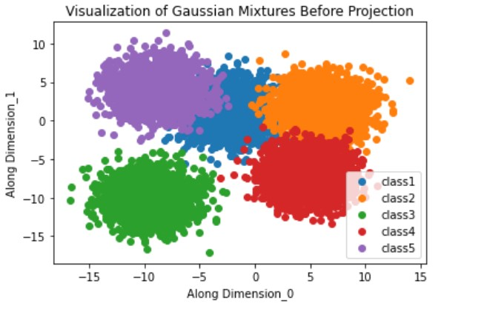
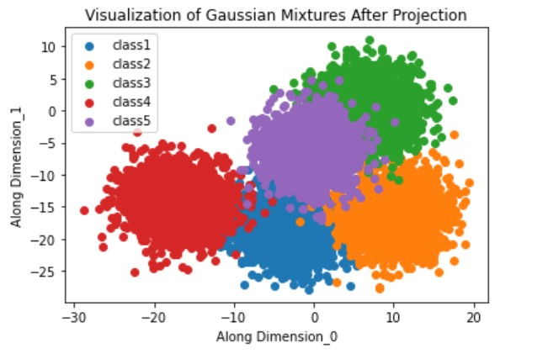
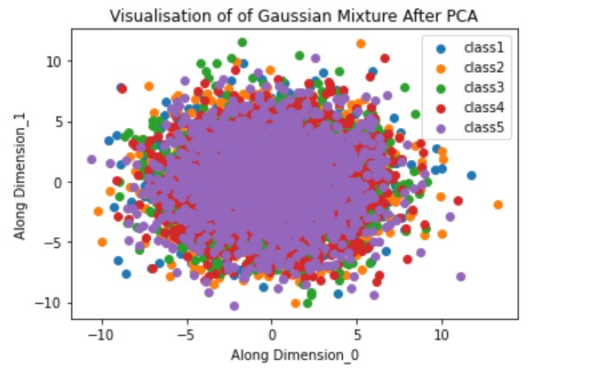
Experiment_3

Slide 11
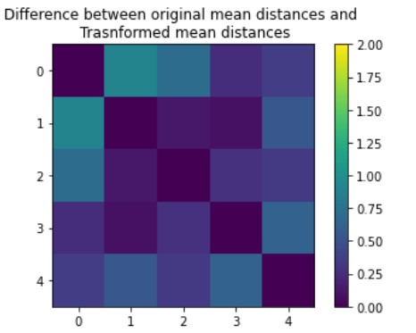
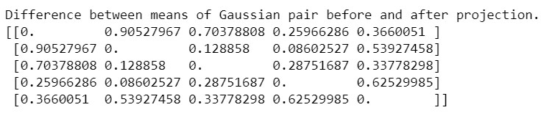
After Applying Random Projection.

Slide 12
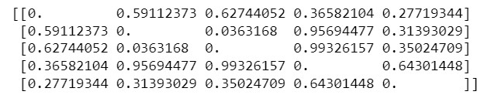
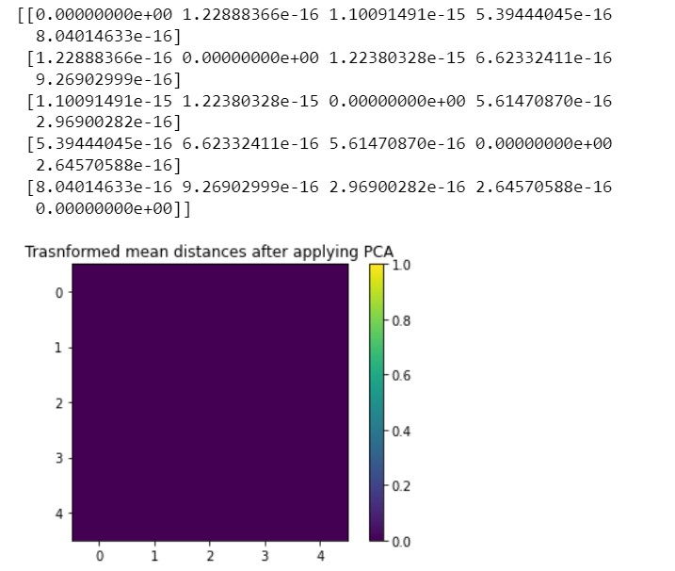
Distances between the mean of Gaussian mixture before PCA.
Distances between the mean of gaussian mixtures after applying PCA.

Slide 13
TimeLine
17 –Dec To 31-Dec
Introduction
1- Jan To 15-Jan
Presentation to the instructor about an understanding of JL lemma and Random projection.
16-Jan To 31-Jan
Mid Evaluation Documentation work.
1-Feb To 15-Feb
Confirmation from instructor
Working on the algorithm and experiment part.
Worked on the Algorithm part.
Documentation Part for Final Evaluation
Generation of synthetic dataset and experimenting.
Project Problem Statement assigned.
Started Reading about JL
Understand JL lemma proof.
Understand Working of random Projection
Prerequisite Knowledge
Started reading and researching about Problem statement.
Did series of Experiments as per objective.
Create a GitHub repository for project work.

Slide 14
Thank You…!

